Slide 1



Making Biosolids Disappear –
The Magic Of Hydrothermal Liquefaction
Michael Washer – Director of The Merrick Consultancy
Presented to: International Biomass Conference & Expo 2018
April 18, 2018
www.merrick.com

Slide 2


Process Overview

Slide 3
Chemical Reactions

Slide 4
A Brief History Of Hydrothermal Liquefaction
1920’s
2007
2010 to Present
1970’s
1990’s
PNNL picks up the baton. Developed complementary Catalytic Hydrothermal Gasification process.
Concept of HTL proposed. First patent in 1925
Explosion of interest in HTL development and commercialization.
OPEC Embargo sparks interest in alternative liquid fuels. Multiple R&D projects, including Shell Oil
RFS II drives development of renewable fuel technologies

Slide 5
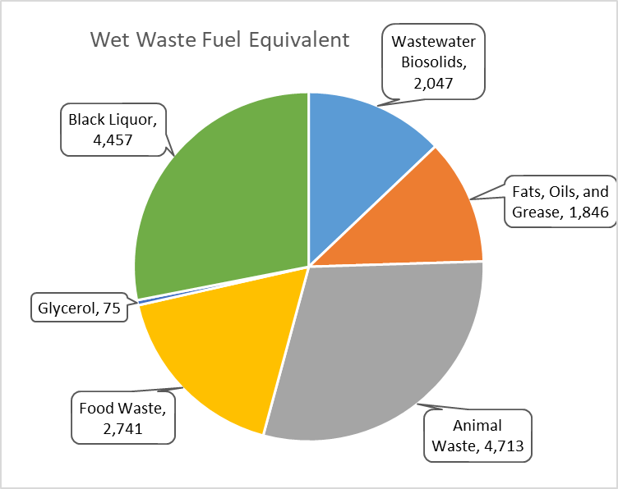
Waste Biomass Feedstocks

Slide 6
HTL Process Schematic

Slide 7
Catalytic Hydrothermal Gasification Process Schematic

Slide 8
1
Carbon conversion in HTL ≈ 50%
Carbon conversion in CHG ≈ 80%
2
PROCESS
Phosphorous recovery ≈ 99%
3
PERFORMANCE
4
Biosolids processed up to 20wt%
5
Energy efficiency > 85%

Slide 9
1
No feed drying
2
Double the energy recovery of pyrolysis
3
Bio-gas is siloxane and H₂S free
HTL & CHG
ADVANTAGES
Footprint is < 50% that of anaerobic digester
4
5
GHG reduction 3X that of anaerobic digester
6
Modular system, fabricated off-site
7
Process is robust and non-biological

Slide 10
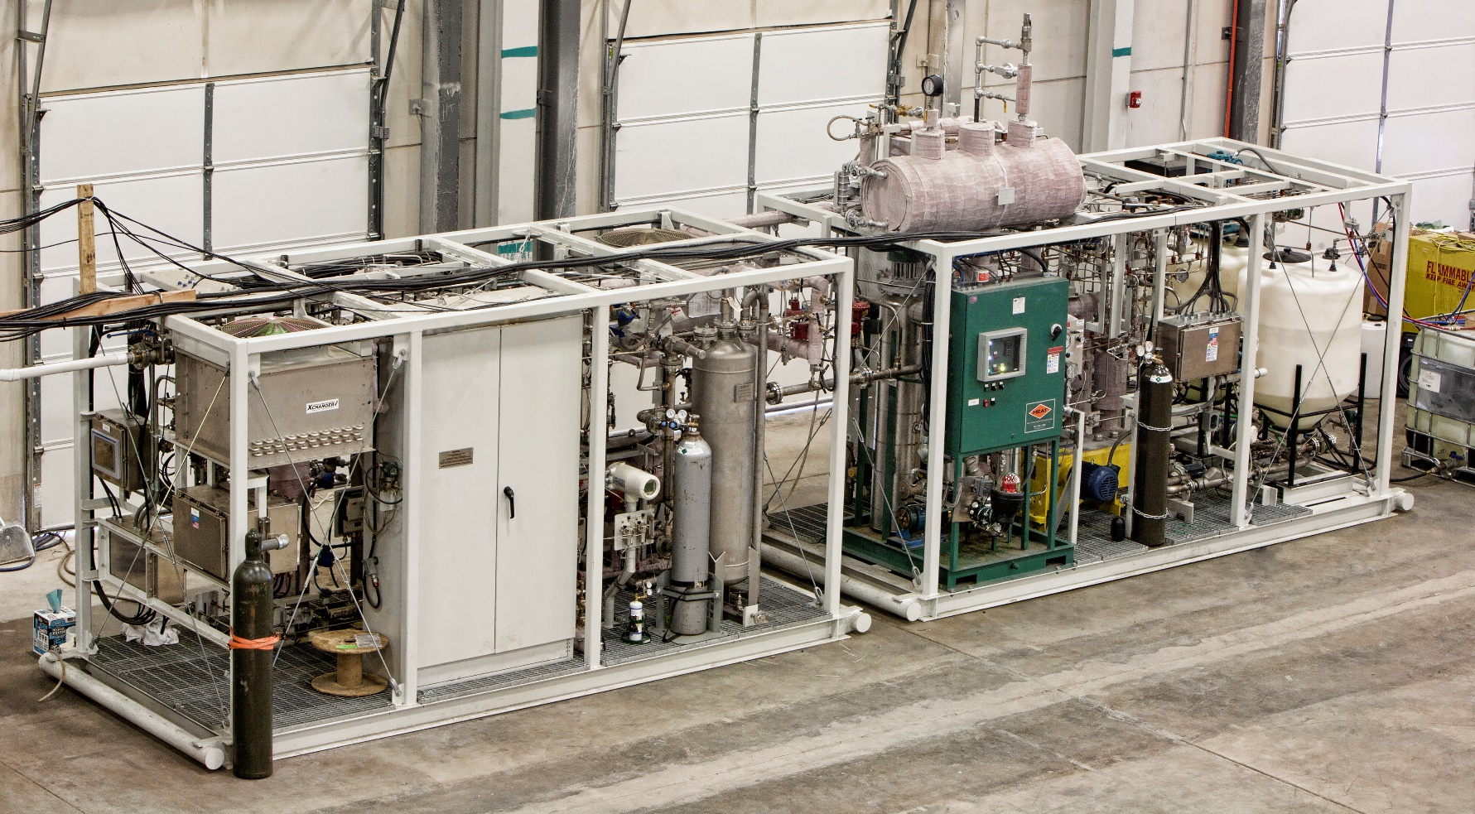
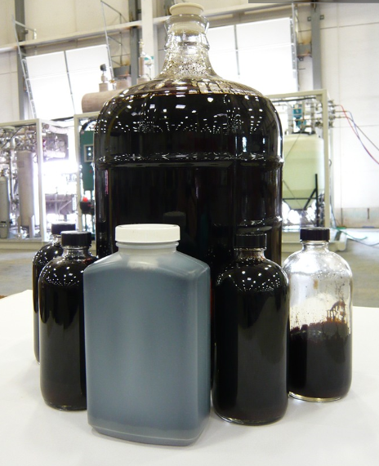
HPPS Project
1
Converts 2 wet tons per day of 20wt% algae into biocrude
2
Designed, built, and commissioned by Merrick

Slide 11
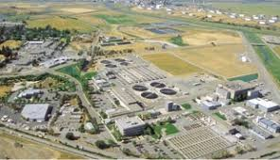
Next Step – The HYPOWERS Project
1
Hydrothermal Processing Of Wastewater Solids
2
Capacity of 15 wet tons per day of biosolids (equivalent to a wastewater plant serving around 45,000 people)
3
Located at the Central San Plant, in Martinez, CA
4
Project is a consortium, including WRF, Merrick, Genifuel, PNNL, Central San & others
5
Cost share, with matching funding from BETO
6
Project will demonstrate all aspects of the HTL and CHG technologies

Slide 12
1
Capital Cost Reduction
Standardization
Modularization
Scale-up
Low Cost Components
Heat Integration
2
PATH TO COMMERCIALIZATION
3
Nutrient Recycle To Fertilizer
4
Biocrude Post Treating
5
Bio-Gas Post Treating
6
Business Model Development

Slide 13
Thankyou
Questions ?
Michael Washer – Director of The Merrick Consultancy
303 353 3875
michael.washer@Merrick.com
www.merrick.com

